Slide 1

Zojila Tunnel Project on EPC Mode (Jammu & Kashmir) INDIA

Slide 2
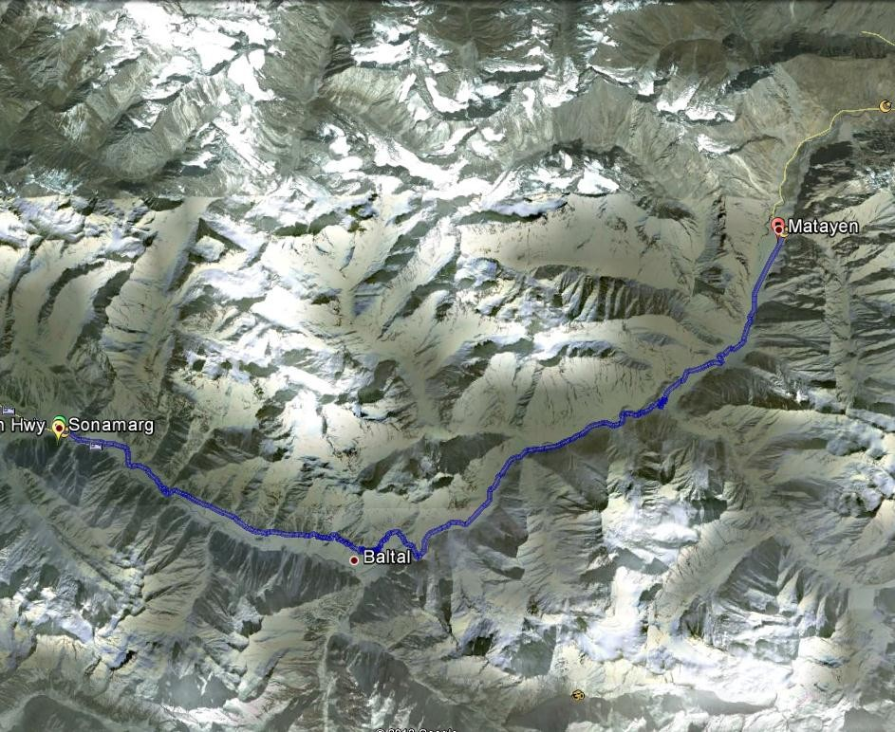
Zoji la tunnel Alignment

Slide 3
Project Status
The DPR for Zozila Tunnel was prepared by 3G - Vyamtech JV and submitted in the year 2013
SCC accorded its approval to the cost amounting to Rs 9240.27 Crore of the project on 23.05.2013
PPPAC accorded the approval to the project on 05.08.2013
CCEA accorded the approval to the project on BOT (Annuity) basis on 17.10.2013
State Support Agreement on 26th November, 2011

Slide 4
ENGINEERING, PROCUREMENT AND CONSTRUCTION BASIS (EPC):
Unforeseen Geological Risk @ 5% of DPR Cost is considered to be paid during the Extraordinary Geological Occurrences (EGO).
Contingencies @2.8% have been taken.
Defect Liability Period including Operation & Maintenance cost for 4 years has been taken @ 0.5% of Civil Construction Cost per year.
Price Escalation during construction period of 7 years has been taken.

Slide 5
SALIENT FEATURES OF TUNNEL
A 14.15 km long Main Tunnel proposed on NH 1 to facilitate all weather connectivity between Srinagar and Leh.
Length of Egress Tunnel is 14.20 km.
Western (Srinagar side) Portal : At Baltal (Km 95) Eastern (Leh side) Portal :At Minamarg (Km 117)
Single tube two way tunnel with parallel egress tunnel.
Three ventilation shafts, of which two shafts also to be used as construction shafts.

Slide 6
SALIENT FEATURES OF TUNNEL
Six working faces proposed.
Estimated time for construction: 84 Months
Total Project Cost: Rs 7440.89 Crore
Defect Liability Period: 4 Years
Operation & Maintenance Period: 4 Years
Civil Construction Cost: Rs 5486 Crore
# Eastern portal face available for working round the year.
# Work not possible at rest of the faces for about four months during the winter period.

Slide 7
FEATURES OF MAIN TUNNEL
S. No. | PARTICULARS | LENGTH
1. | Length of Main Tunnel (including cut & cover portals) | 14.15 Km
2. | Cut & Cover (West Portal) | 37.017 m
3. | Cut & Cover (East Portal) | 30.00 m
4. | Total Length of the Project | 14.31 Km

Slide 8
TUNNEL SYSTEM SOLUTION
Design speed: 80 Kmph
Gradient west to east :2.9% (1 in 35)
Total no. of curves: 9
Main Tunnel: 14.15 km length
Parallel Escape Tunnel: 14.20 km length
Ventilation Sections: 8

Slide 9
Western Portal (Srinagar side)
Portal elevation = 2900 m
Cut and cover tunnel length= 37.017 m
Ventilation building = above C&C tunnel, 2 axial fan, electrical supply installation
Service and control buildings.(800sqm)

Slide 10
Eastern Portal (Leh Side)
Portal elevation = 3310 m
Cut and cover tunnel length=30m
Service and control buildings (800sqm)

Slide 11
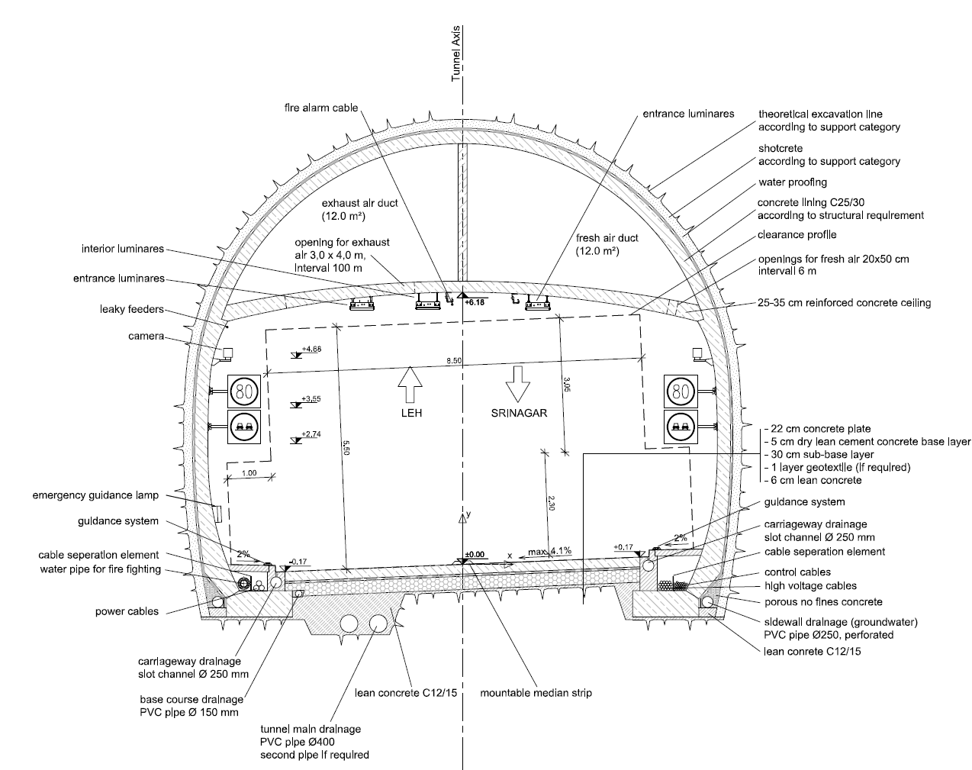


Proposed Tunnel Cross Sections (Main Tunnel)-1

Slide 12
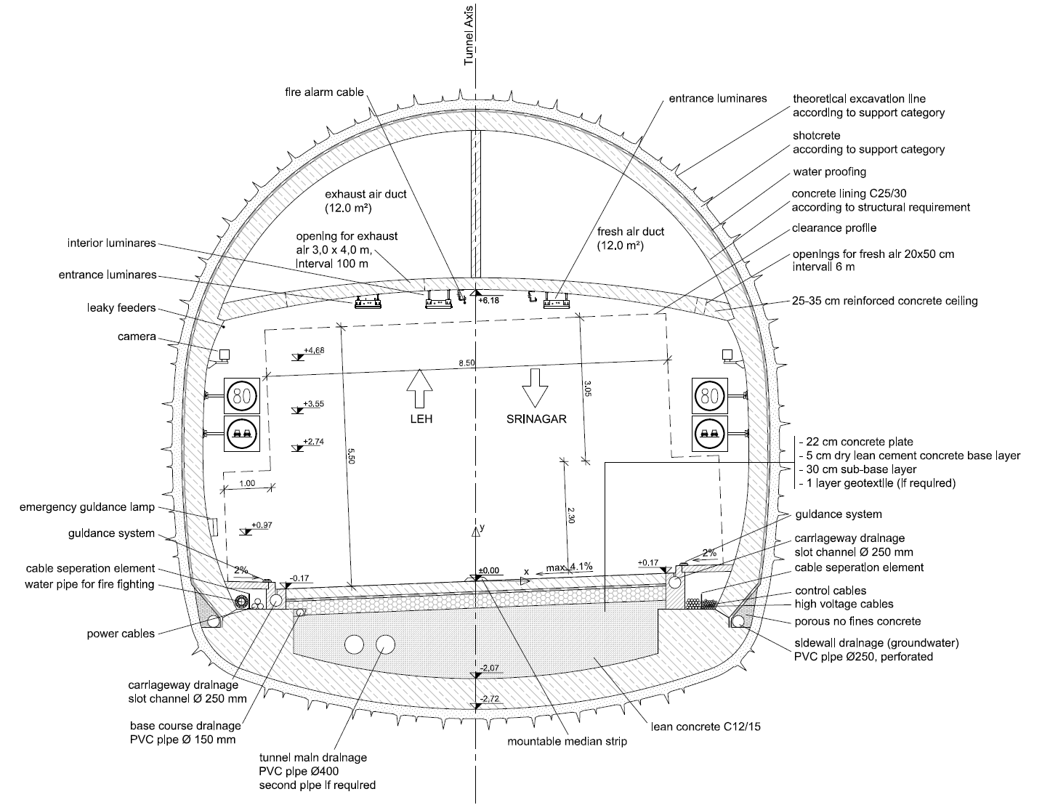

Proposed Tunnel Cross Sections (Main Tunnel)-2

Slide 13
Ventilation Shafts
Shaft No. 1
Ventilation cum Construction Shaft No. 1 (Depth =484 m, Proposed Dia. = 14m)
Shaft No. 2
Shaft No. 3
Ventilation Shaft No. 3 (Depth = 208m, Dia. = 6m)
Ventilation cum Construction Shaft No. 2 (Depth = 365m, Proposed Dia. = 14m)

Slide 14
Facilities & Safety Features
Pedestrian Cross Passages | At every 250m (As per Codal provisions)
Vehicular Cross Passages | At every 750m (As per Codal provisions)
Lay-bys (Both highway side)(BHS) | At every 750m Width = 3m Length = 40m Hydrant Cabinet and Emergency Telephone Cabinet
Jet Fan Cabinets | On Both Highway Sides (BHS) at an interval of 400 to 600 m with a length of 30m
Emergency Telephone & Communication System | At emergency exits and at an interval of 125 m on one side of the tunnel
Electrical supply cabinet | Every 700m

Slide 15
Facilities & Safety Features
Uninterruptible Power Supply (UPS) system Tunnel emergency lighting Emergency call system (ECS) CCTV monitoring Variable message signs (VMS) Traffic lights Over height vehicle detection Traffic logging equipment Guidance system Tunnel radio system Internal telephone system Sound system Tunnel physical variables measurement system Escape route lighting Integrated tunnel control system- Supervisory Control and Data Acquisition (SCADA)

Slide 16
Function (SCADA SYSTEM)
The ventilation shall be monitored and controlled in the Operating & Maintenance Centre (OMCs) via the Supervisory Control and Data Acquisition (SCADA) system.
When the ventilation system function works in the normal mode of operation, the fresh air shall be introduced through the inlet portal and it shall push the engine emissions along the tunnel length up to the outlet portal or the exhaust shafts where the emissions shall be vented.
The jet fans shall be fully reversible and may be activated from the tunnel control centre by means of the Programmable Logic Controller (PLC) in accordance with the functional protocols to be established.
Each fan and jet fan shall be connected to the SCADA system via a PLC. The SCADA system shall be programmed to identify each cable for all of the fans.
The SCADA system shall monitor the data received from all of the pollution measurement sensors. When the SCADA system detects values exceeding their defined limits, it shall then instruct the appropriate fan to switch on.
A data cable from the fan motor shall be wired back to the SCADA system via the PLC and this shall inform the SCADA system about the current status of the fan (for example motor run status, motor speed, etc.)
The fans can be switched on as required from the PLC to adjust the system performance to the particular necessities, i.e. light traffic hours, peak hours, emergency, etc.

Slide 17
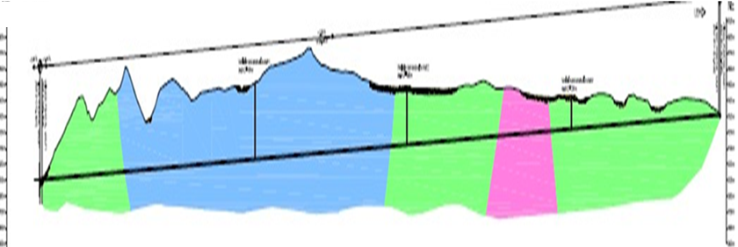
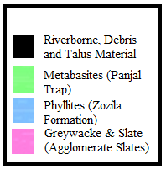
Zojila Tunnel-Indicative Geology
S. No. | Section Number | Section Detail | Section Length (in metres)
1 | Section - 1 | Slope, Debris and Talus Material | 126
2 | Section - 2 | Metabasites (Panjal Trap) | 1640
3 | Section - 3 | Phyllites (zojila Formation) | 5550
4 | Section - 4 | Metabasites (Panjal Trap) | 2217
5 | Section - 5 | Greywacke & Slate (Agglomerate Slates) | 1113
6 | Section - 6 | Metabasites (Panjal Trap) | 3500
7 | Section - 7 | Riverborn Material | 36

Slide 18
Land Acquisition & Forest Diversion
Land Acquisition & Forest Diversion Permissions are obtained for the Project
Forest Land = 208.88 HA
Forest Area = 97.82%
Payment = 16.92 Cr paid on March 2014 to PCCF
Revenue Land = 4.60 HA
Revenue land Area = 2.18%
Payment = 3.94 Cr 31st March 2014, DC Ganderbal

Slide 19
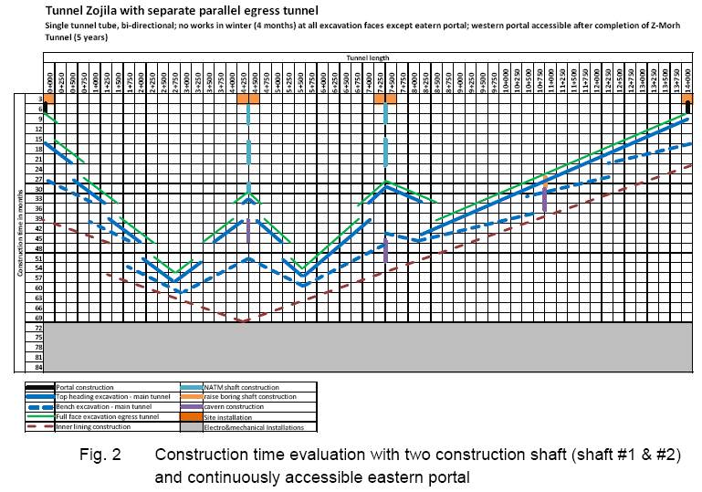
9-Aug-16

Slide 20
Muck Disposal Sites and Their Capacities
S. No. | General Area | Pocket | Approx Area In Sq M
1 | Baltal | B 1 | 155361.75
2 |  | B 2 | 65645.289
3 |  | B 3 | 59576.723
4 |  | B 4 | 164496.28
5 |  | B 5 | 19858.898
6 |  | B 6 | 98125.188
7 |  | B 7 | 59637.234
 | Gumri
8 |  | G 1 | 150838.03
9 |  | G 2 | 58759.207
10 |  | G 3 | 2217.805
 | Machoi-Minamarg
11 |  | M 1 | 59323.469
12 |  | M 2 | 73709.831
13 |  | M 3 | 29879.09
14 |  | M 4 | 19959.721
15 |  | M 5 | 33286.363
16 |  | M 6 | 17036.328
17 |  | M 7 | 115611.68
18 |  | M 8 | 51048.48
19 |  | M 9 | 25463.756
20 |  | M 10 | 50221.875
Note:- (a)Total number of pockets identified - 20
(b)Total approximate area - 1310057 Sq m

Slide 21
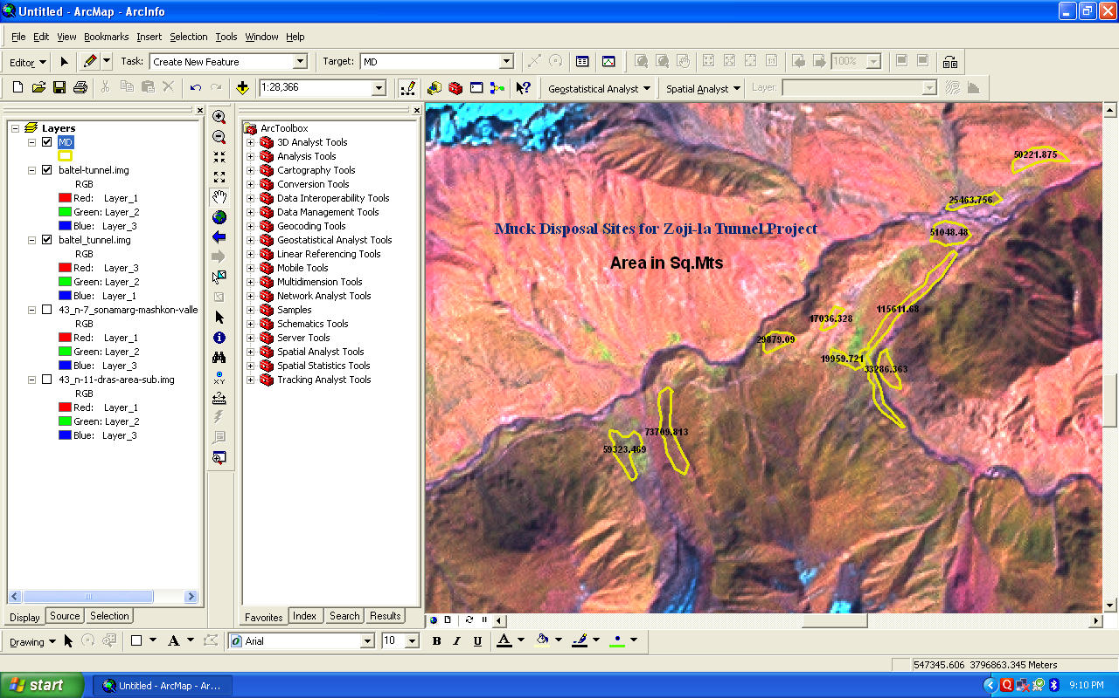
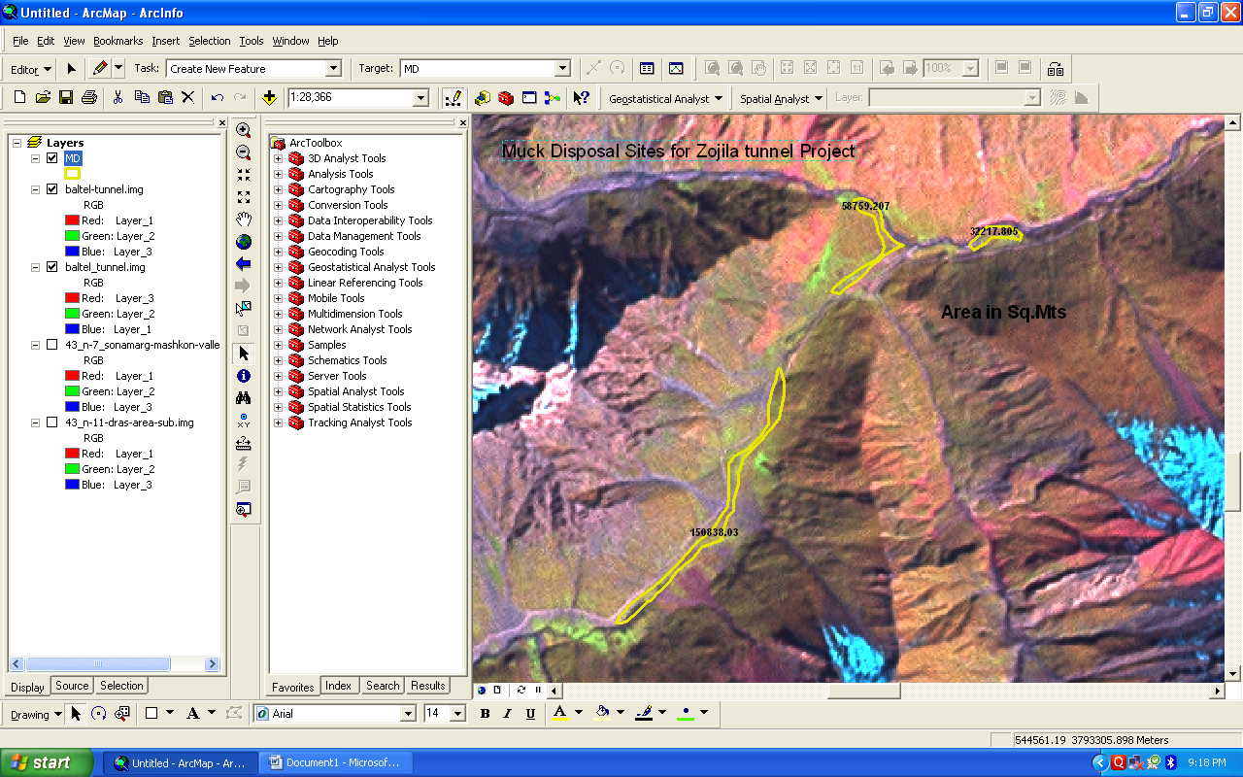
Photos of Muck-Disposal Sites

Slide 22
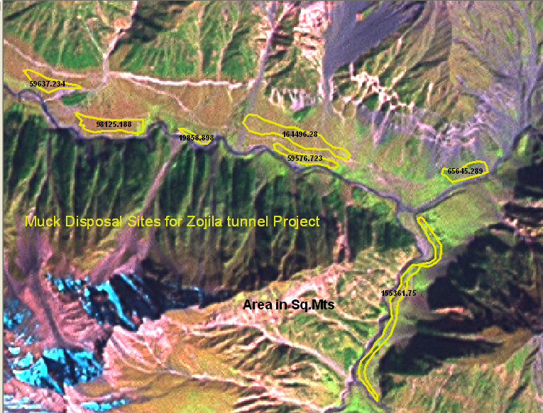
Photos of Muck-Disposal Sites

Slide 23
ZOJILA TUNNEL – PROJECT SITE CONDITIONS
No human habitation and no vegetation.
Lack of oxygen.
Heavy snowfall area. Snow accumulation upto 25-30 feet.
Remains closed from November- March.
Peak minimum winter temperature can touch – 45̊ C.
High wind chill factor.
400 KM away from rail head at Jammu and 108 Km from Srinagar.

Slide 24
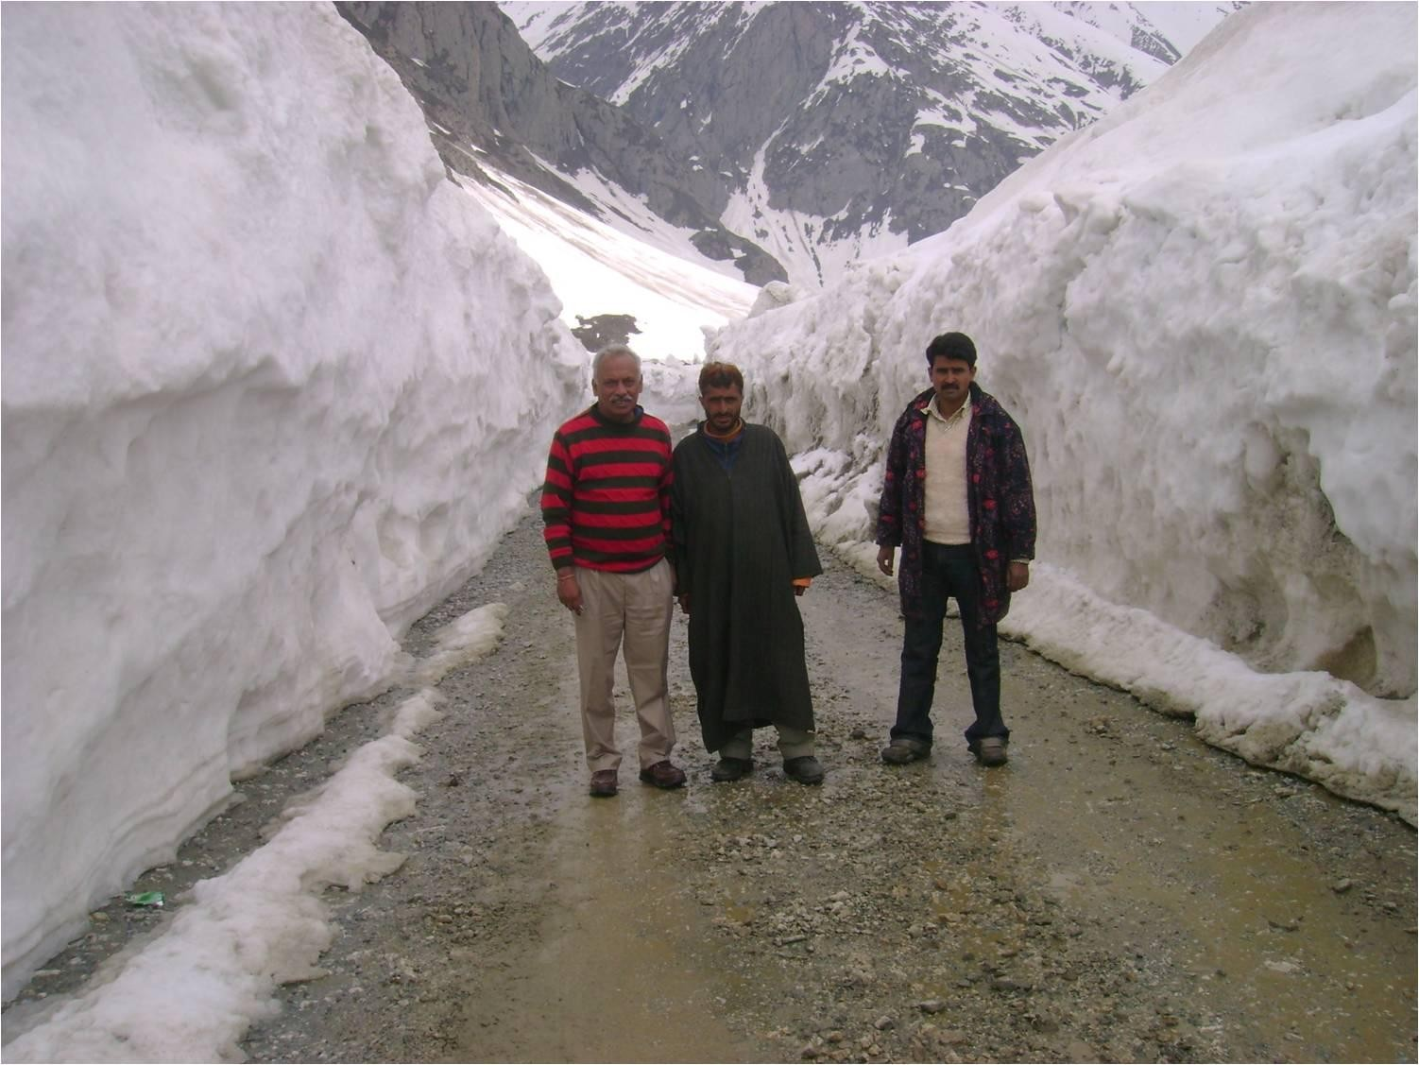
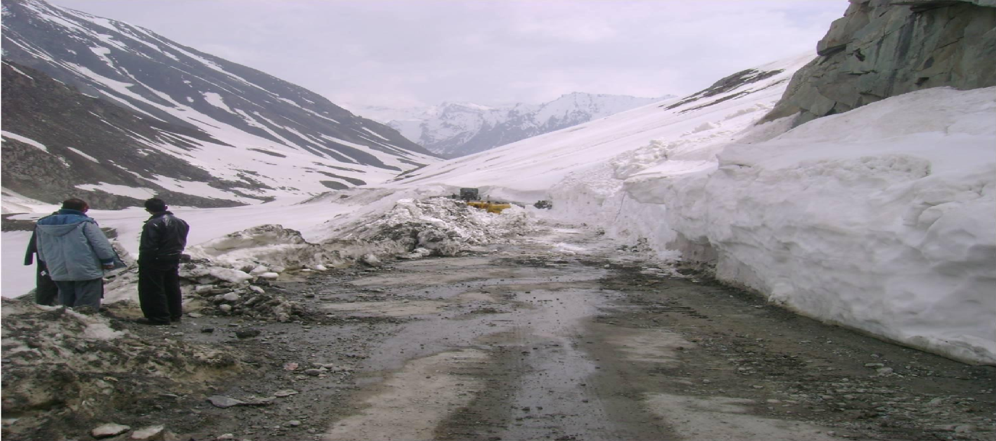
APRIL MONTH: DAY 1 OF ROUTE OPENING

Slide 25
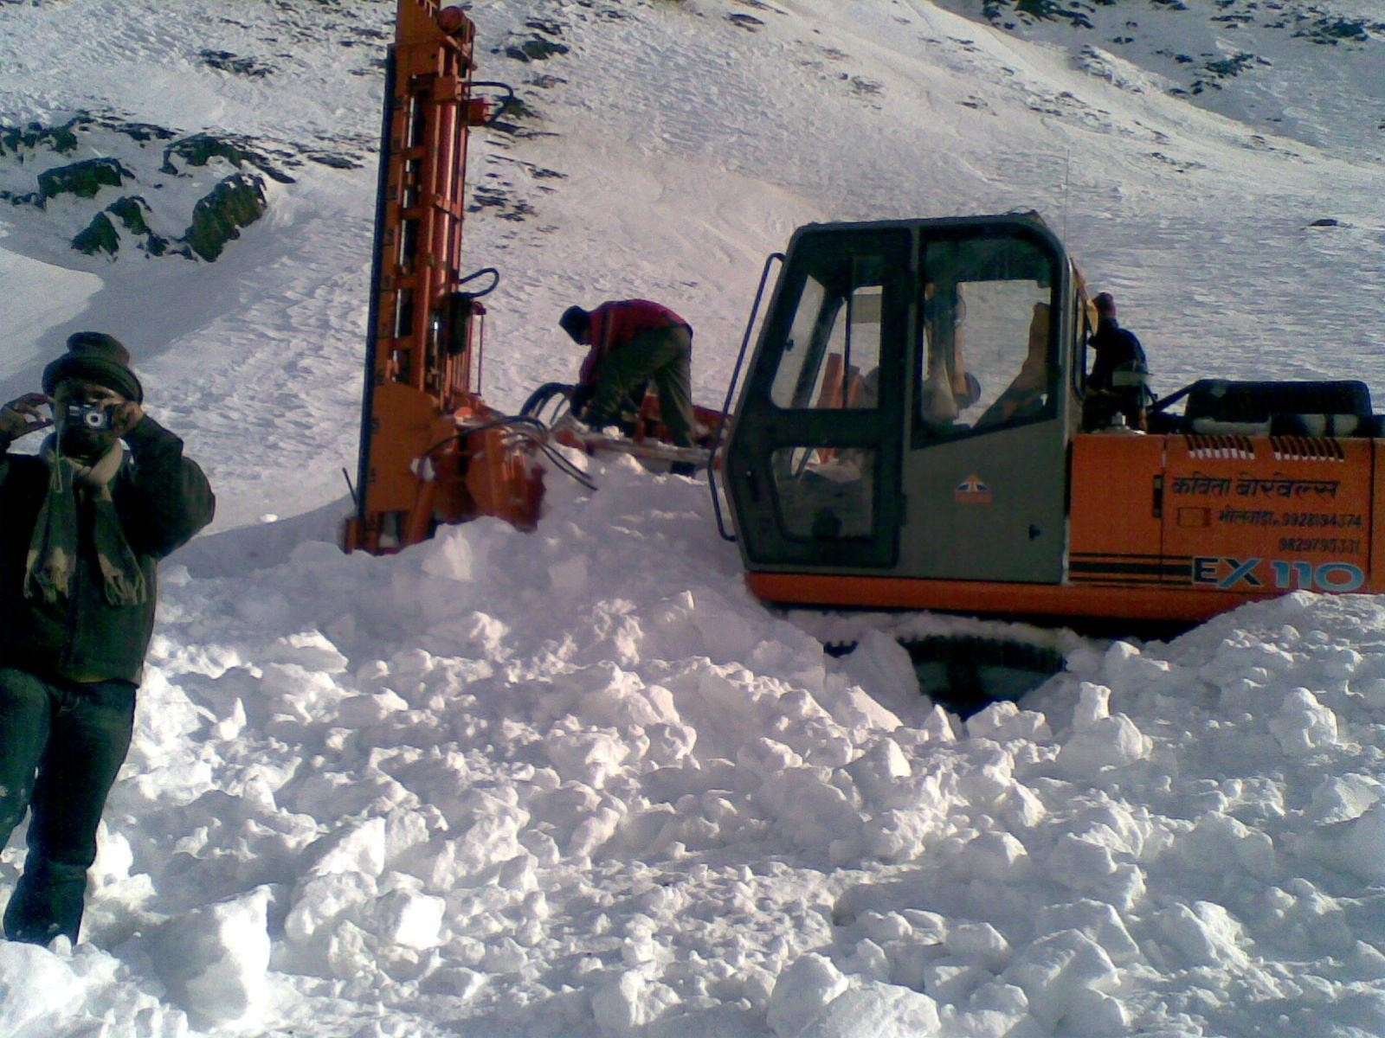
MACHINE IN SNOW

Slide 26
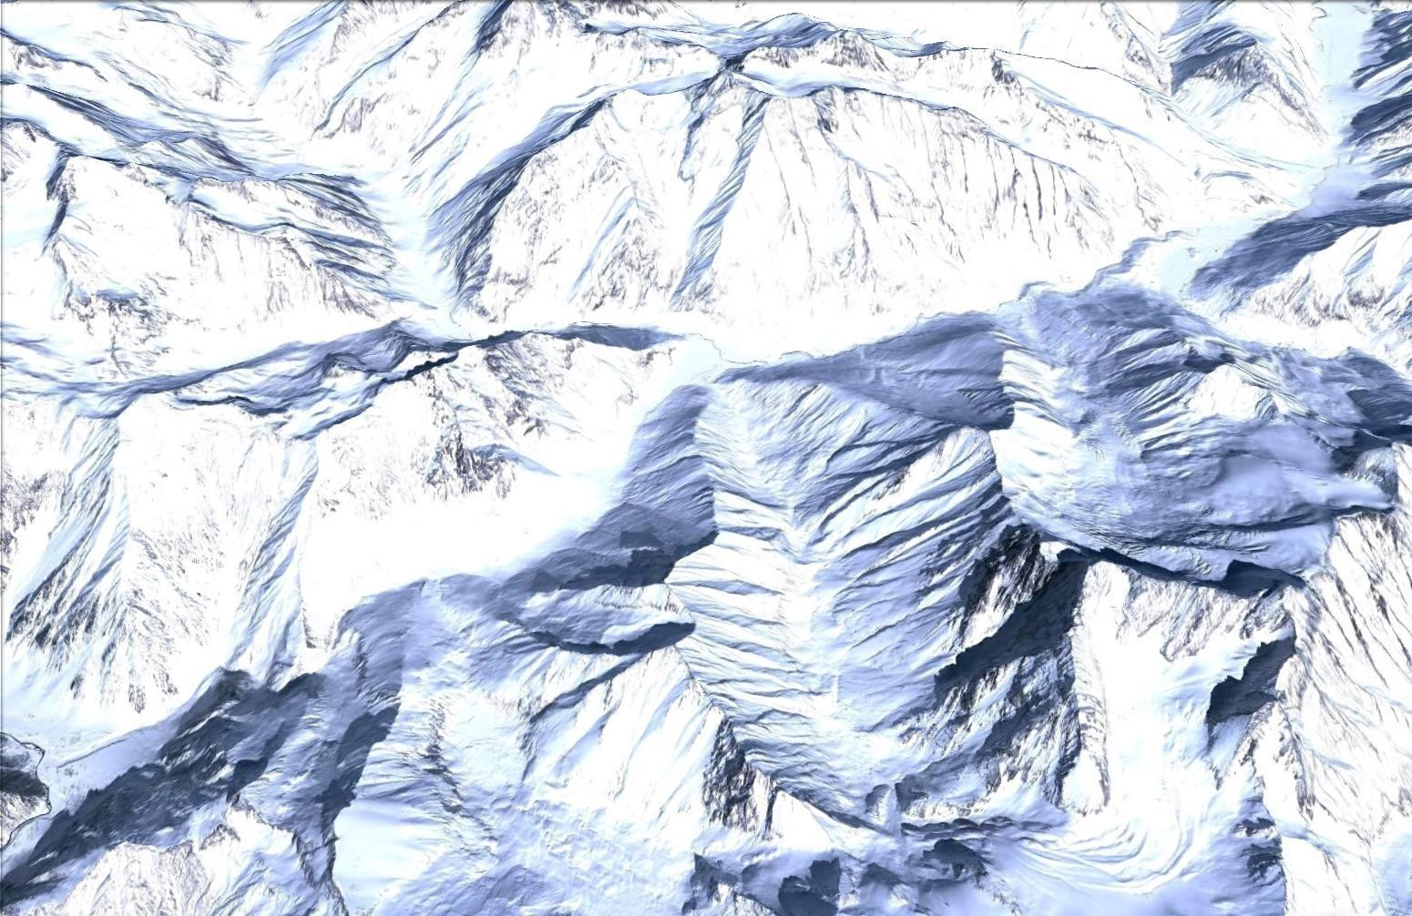

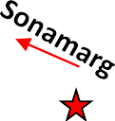


Registered Avalanche Sites Between Baltal and Minamarg
9-Aug-16
SL-76
SL-75
MINAMARG
SL-72
SL-74
SL-67 SL-66
SL-70
SL-71 SL-73
GUMRI
SL-65
SL-59
_{SL-61} SL-62
SL-69
SL-63
SL-64
SL-68
SL-60
SL-49
SL-50
SL-54
SL-57
SL-58
SL-55
SL-51
SL-53
SL-56
SL-52
BALTAL
Courtsey SASE

Slide 27
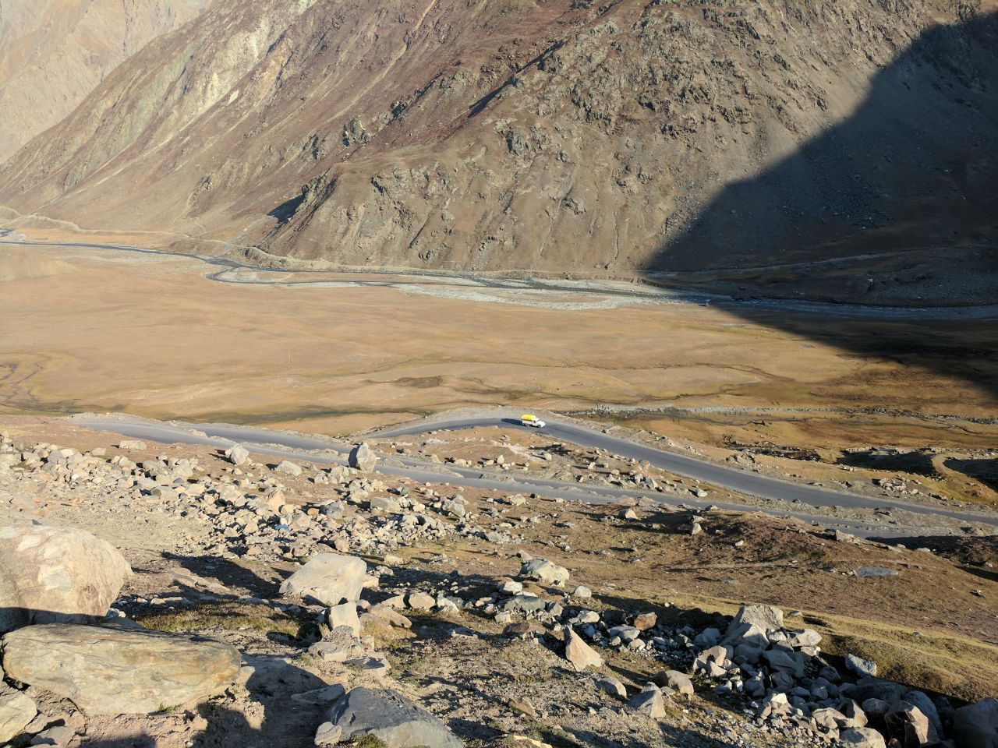
PRESENT CONDITION (EASTERN PORTAL SIDE)

Slide 28
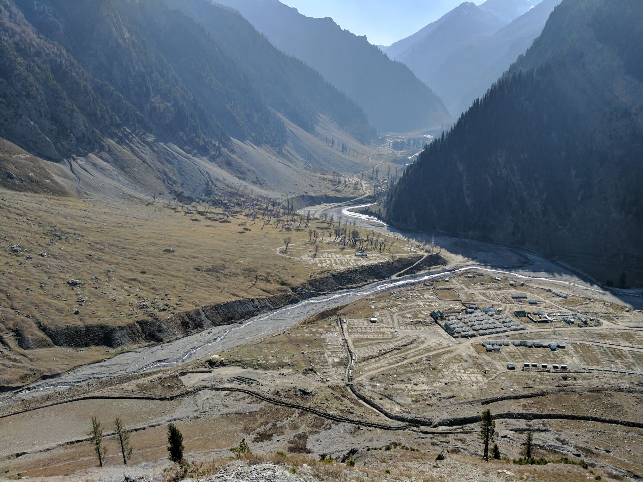
PRESENT CONDITION (WESTERN PORTAL SIDE)

Slide 29
Proposed Modification in the Standard Bid Document on EPC Basis
Maximum limit of Bonus for Early Completion is proposed to be increased from 3% to 10%
Geological risks to be shared between the Authority and the Contractor, have been detailed
Defect Liability Period including Operation & Maintenance cost for 4 years
Contractor is free to take-up the work either by NATM or TBM or any other method proposed by contractor in his technical proposal maintaining the minimum clearance profile

Slide 30
Details to be submitted in Technical Proposal
Staffing schedule and Organisation Chart
Tender Programme and Proposed Design Submission Programme
Details of works including specialist work proposed to be sub-contracted
Outline Quality Plan
Outline Safety Health and Environment (SHE) Plan
Contractor’s Equipments
Proposed Construction Method Statement

Slide 31
THANK YOU

